Slide 1

EM Crosstalk: Solutions for Multiconductor Lines
Farhad Rachidi
Swiss Federal Institute of Technology (EPFL)
EMC Laboratory
Farhad.Rachidi@epfl.ch
http://emc.epfl.ch

Slide 2
This Chapter is based on the lecture of Prof. F.M. Tesche, Clemson University

Slide 3
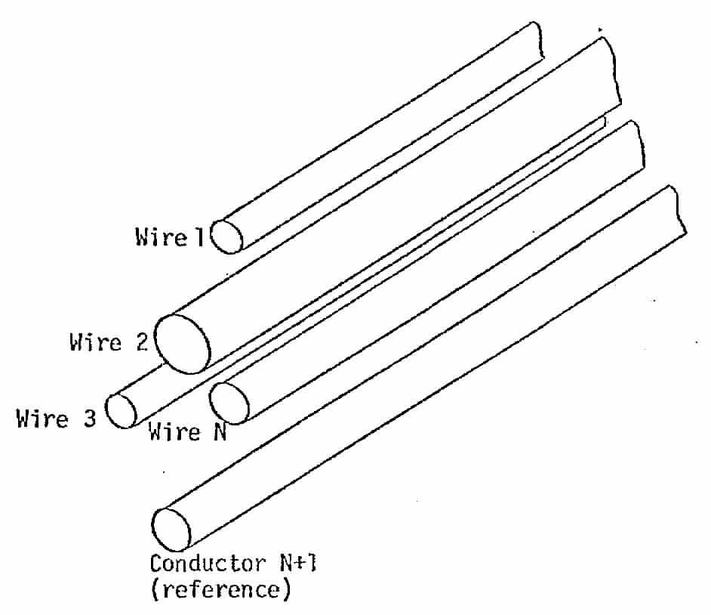
Multiconductor Line Parameters
Line Currents
Consider a bundle of N wires, plus a N + 1 “reference” conductor, located in free-space
  we can define line currents in each of the N-wires
  Together with a return current in
  the reference conductor
  Note that a requirement for the TEM
  mode is that the sum of all such
  currents (in any cross-section of the
  line) must equal zero

Slide 4
Multiconductor Line Parameters
Line Voltages
For the same bundle of N wires, we can define N voltages, using the N+1 conductor for the 0-volt reference
  For the case of a line over a
  groundplane, the N+1st reference
  wire is the ground
  For a shielded multiwire line,
  the N+1st reference wire is the shield
+ V₁
+ V₂

Slide 5
Multiconductor Line Parameters
Line Inductance Matrix
Consider an N-wire line (plus reference) with 1 wire carrying current I₁
  With a return current –I in the
  reference
The H-field from the current in
wire 1 is
Adding the return current
provides another H-field
In the thin-conductor
approximation, these
H-fields are independent
of the presence of other conductors

Slide 6
Multiconductor Line Parameters
Line Inductance Matrix
The partial, per-unit-length
magnetic flux flowing
between wire #1 and the reference
conductor is proportional to the
wire current I₁, as
where L’₁₁ is the per-unit-length
inductance of the wire #1 circuit
Similarly, the partial flux from circuit #1 that links wire #2 and the reference conductor is given by the mutual inductance L’₁₂ and the current in wire #1 as:

Slide 7
Multiconductor Line Parameters
Line Inductance Matrix
Combining these partial fluxes gives the total per-unit-length flux linking wire #1 and the reference conductor as
This is the flux for circuit #1. As there are N such circuits, all fluxes can be expressed in matrix form as
  Or in a shorthand notation,
The (N x N) per-unit-length inductance matrix of the N-wire line

Slide 8
Multiconductor Line Parameters
Line Inductance Matrix
Because the self and mutual inductances are independent of the presence of other conductors, they are easy to compute
For an N-wire line, the inductance matrix is expressed as
  where [F] is an NxN matrix of terms depending only on the geometry of the conductors
  This matrix is given in the next vugraph

Slide 9
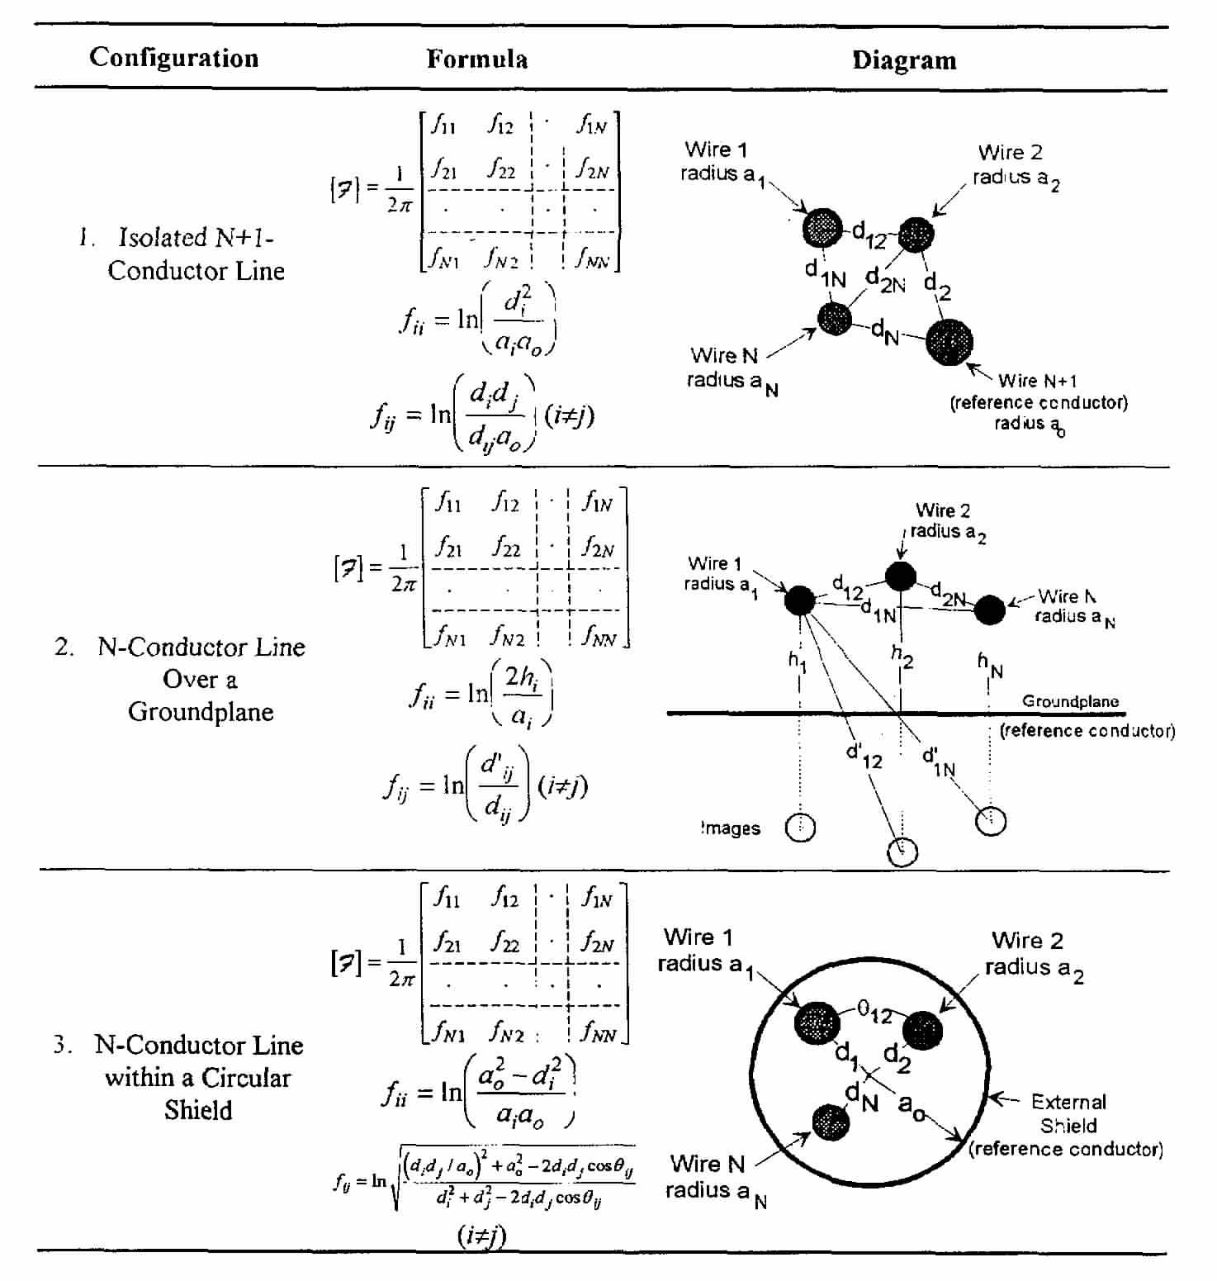
Multiconductor Line Parameters
Line Inductance Matrix
Matrix [F]

Slide 10
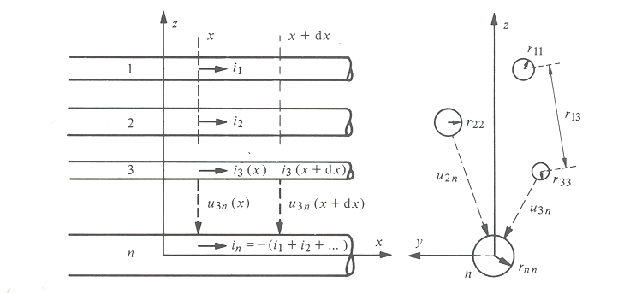
Line Inductance Matrix
Example: N-conductor line in free space
N conductors in the free space. The conductor N is the return conductor.

Slide 11
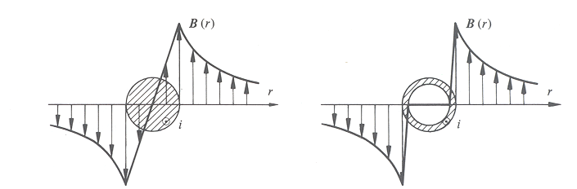
Line Inductance Matrix
Example: N-conductor line in free space
Magnetic field distribution around the conductors

Slide 12
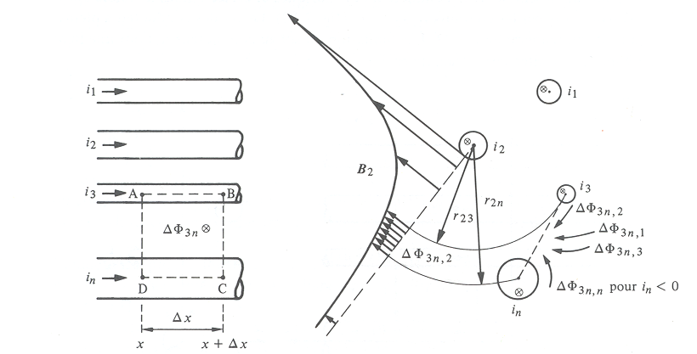
Line Inductance Matrix
Example: N-conductor line in free space
Assume that the currents are concentrated on the conductors’ surface. Let us calculate as an example the mutual inductance between conductors 2 and 3. To do this, we will first determine the magnetic flux due to the current i₂ through the circuit formed by the conductor 3 and the return conductor n
Integration
contour

Slide 13
Line Inductance Matrix
Example: N-conductor line in free space
This flux has two terms: first the contribution of the current i₂ flowing in the conductor 2

Slide 14
Line Inductance Matrix
Example: N-conductor line in free space
And the second the contribution of the current i₂ returning in conductor n

Slide 15
Line Inductance Matrix
Example: N-conductor line in free space
The total flux is then given by
And therefore the mutual inductance per unit length

Slide 16
Multiconductor Line Parameters
Line Capacitance Matrix
The per-unit-length capacitance matrix is the dual of the inductance
  Providing a relationship between the per-unit-length charge on each conductor and the wire voltages (with respect to the reference):
Unfortunately, unlike the L’ matrix, the individual elements of C’ cannot be written simply
  Due to the charge on one conductor affecting the voltage of another wire
or

Slide 17
Multiconductor Line Parameters
Line Capacitance Matrix
Wire 2
Consider a 3-wire line
over a ground
  The capacitances C’_{ij}
  denote the partial
  (physical) capacitances
  between all wires and the
  neutral conductor
On wire #1, the charge is expressed as
Q’₁ = C’₁₂·v₁₂ + C’₁₃·v₁₃ + C’₁₁·v₁ = C’₁₂(v₁ - v₂) + C’₁₃(v₁ - v₃) + C’₁₁·v₁
= (C’₁₁ + C’₁₂ + C’₁₃)·v₁ - C’₁₂·v₂ - C’₁₃·v₃
In a similar way one finds
Q’₂ = - C’₂₁·v₁ + (C’₂₁ + C’₂₂ + C’₂₃)·v₂ - C’₂₃·v₃
and
Q’₃ = - C’₃₁·v₁ - C’₃₂·v₂ + (C’₃₁ + C’₃₂ + C’₃₃)·v₃
V
12
-
Wire 1
+
C'
C'
+
V
23
12
23
-
C'
13
Wire 3
+
V
-
+
C'
13
+
C'
+
C'
V
1
11
V
22
V
33
2
-
3
-
-
Neutral

Slide 18
Multiconductor Line Parameters
Line Capacitance Matrix
Thus for an N-conductor line, we have the Q’-V relationship in terms of the physical capacitances,
The C’s are all positive-valued capacitance elements
or
And the off-diagonal terms of the [C´] matrix are negative.

Slide 19
Multiconductor Line Parameters
Line Capacitance Matrix
Observe that for 2 thin conductors of radius a and separation b, the term K’₁₁ is given as
The [C´] matrix is difficult to calculate directly, since each element depends on the geometry of all conductors
  However, we can evaluate its inverse:
With only 1 wire charged, the voltages of each wire can be calculated independently
This and the other terms of K’_{ij} are related to the elements in the [F’] matrix used to compute the line inductance
0

Slide 20
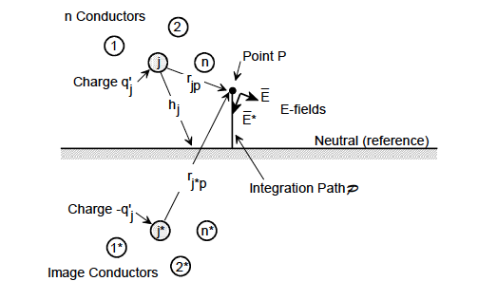
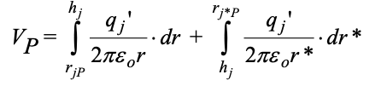



Multiconductor Line Parameters
Line Capacitance Matrix
For a configuration of n arbitrary conductors, the potential of the k^{th} conductor with respect to the ground (taken as the (n+1)^{st} conductor) due to the charges on all of the other conductors (j = 1 to n) is expressed as

Slide 21
Multiconductor Line Parameters
Line Capacitance Matrix
Thus, the [K´] matrix can be calculated from the geometry matrix [F] used to calculate the inductance matrix:
And the capacitance
matrix is given
by

Slide 22
Multiconductor Line Parameters
L’ and C’ Matrix
Note that for the multiconductor line with no dielectric filling, we have
Observe that the product of these matrices is
Where c is the speed of light and [U] is the NxN unit matrix
As we show later, this relationship implies that all of the multiconductor fields (modes) propagate at the same velocity, c

Slide 23
Multiconductor Line Parameters
Effect of dielectrics on capacitance parameters
If the entire region surrounding
the conductors is filled with a
dielectric, the capacitance is
still given by the relationship
with the modified dielectric
constant
  And of course, the wave speed is less than in free space
If the line has a dielectric surrounding
each conductor, then finding the
capacitances becomes more difficult
  And the velocity relationships are more
  interesting

Slide 24
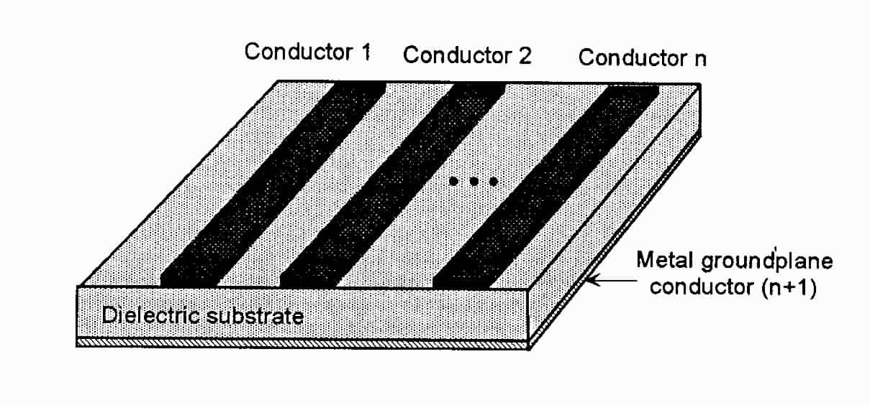
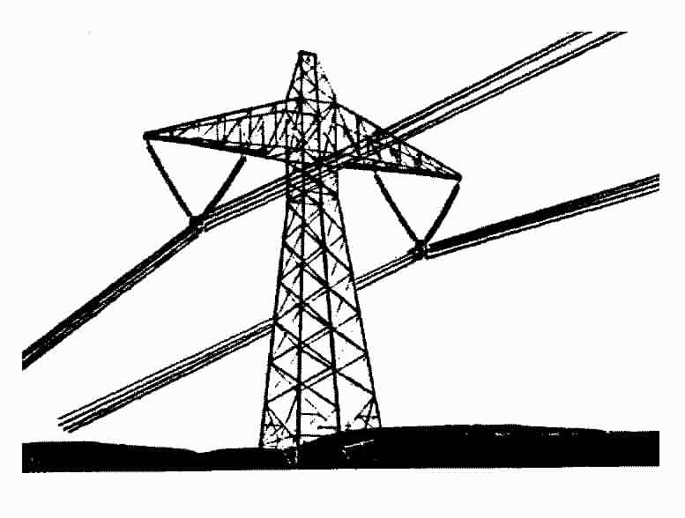
Multiconductor Line Parameters
Effect of dielectrics on capacitance parameters
Dielectric effects can occur in lines
like the isolated line shown here
For microstrip lines on a
printed circuit board
Or for a power line over the earth

Slide 25
Multiconductor Line Parameters
Effect of dielectrics on capacitance parameters
Unfortunately, in these cases we cannot compute the capacitance coefficient matrix [C’] from the inductance (or [F] matrix)
  We must use a numerical solution, taking into account the presence of the dielectric
  Consider the following dielectric coated wire (one of many in a bundle)
For the conductor at a specified potential V, the conductor charge and the dielectric polarization charges are unknown. These need to be evaluated to determine the [C’] matrix.
In addition, if adjacent wires are close enough, they will modify the charge distribution, and this affects [C’]
One approach is to develop an integral equation solution for the charge, and then find [C’]

Slide 26
Multiconductor Line Parameters
Experimental Determination of Inductances
Conductors open-circuited
at x=0
Conductors short-circuited
at x=L
N-wire line
Wire i
Wire j
+
+
Voltage
source
V
High impedance voltage meter
measuring U_{j}
U
i
V
i
Reference conductor
x =0
x =
L
L
For λ >> L
with

Slide 27
Multiconductor Line Parameters
Experimental Determination of Inductances
Conductors open-circuited
at x=0
Conductors short-circuited
at x=L
N-wire line
Wire i
Wire j
+
+
Voltage
source
V
High impedance voltage meter
measuring U_{j}
U
i
V
i
Reference conductor
x =0
x =
L
L
For λ >> L
with

Slide 28
Multiconductor Line Parameters
Experimental Determination of Capacitances
Conductors short
-
-
circuited
Conductors open
-
-
circuited
circuited
at x=0
at x=0
at x=L
N
at x=L
N
-
-
wire line
wire line
Wire i
Wire i
Wire j
Wire j
+
+
+
Voltage
+
Voltage
A
V
A
V
Low impedance
source
Low impedance
source
U
current meter
j
current meter
Reference conductor
Reference conductor
x =0
x =0
x =
x =
L
L
L
L
For λ >> L
with

Slide 29
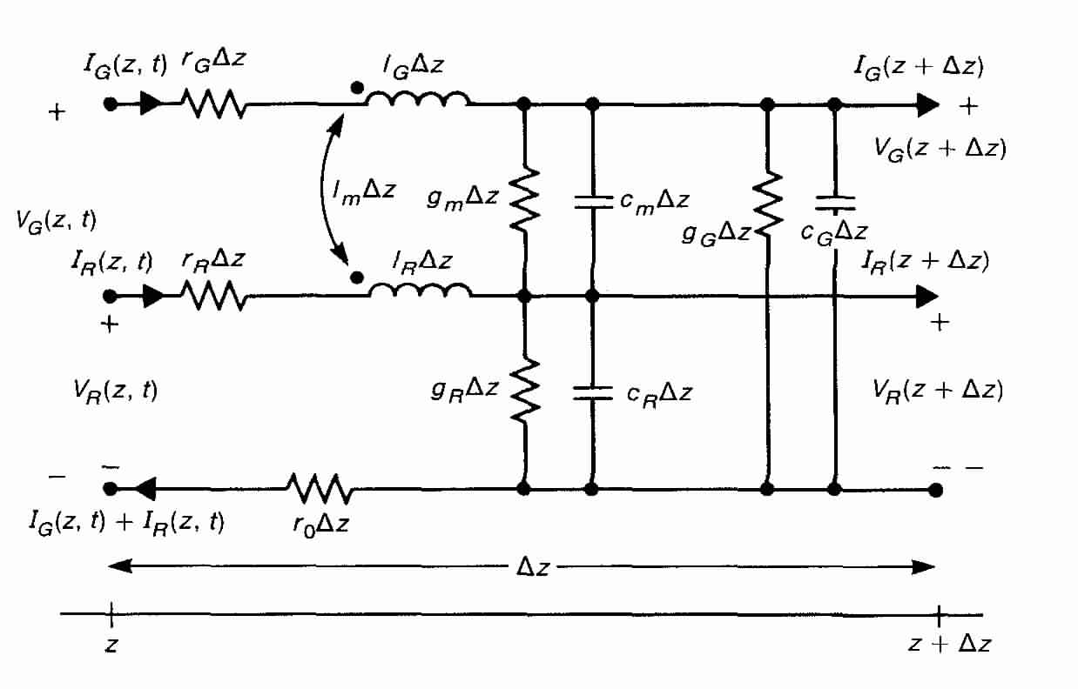
Telegrapher’s Equations for
Multiconductor Lines
The [L’] and [C’] matrices can be used in a per-unit-length model to describe the behavior of voltage and current on a multiconductor line
This circuit can be used to derive the Telegraphers’ equations for the multiconductor line
Neglect, for the moment, the resistance and conductance elements – we are discussing a lossless line
Remember that these values of capacitance are the physical elements, C, not the elements of the [C’] matrix!

Slide 30
Telegrapher’s Equations for
Multiconductor Lines
Note that for this line, the voltage and line current can be represented compactly as N-vectors
By examining the voltage-flux relationships on the multiconductor circuit,
we have
First Telegrapher Equation

Slide 31
Telegrapher’s Equations for
Multiconductor Lines
Similarly, from the charge-voltage equation
We get
Second Telegrapher Equation

Slide 32
Telegrapher’s Equations for
Multiconductor Lines
Thus, these Telegraphers’ equations are two coupled NxN matrix equations of the form
These must be solved in a self-consistent manner for the line voltage and current vectors
  Taking into account the termination impedances and the excitation sources of all of the lines.

Slide 33
Telegrapher’s Equations for
Multiconductor Lines
From these first-order differential equations, two wave equations can be derived, just like for the 2-conductor line.
  These are
  We can solve these symbolically, as
  However, we must define what is meant by
Note that the order of matrix multiplication is important.

Slide 34
Multiconductor Lines
Solutions to the Matrix Wave Equations
Consider first the NxN matrix wave equation for the voltages on the N-wire line
Recall from the definitions of [Z’] and [Y’], we have
If [P] were diagonal as,

Slide 35
Multiconductor Lines
Solutions to the Matrix Wave Equations
  Then the overall matrix equation could be written in terms of individual, uncoupled wave equations as
However, in the general case, [P] is not diagonal
The task, therefore, is to find some way to diagonalize the propagation matrix [P]

Slide 36
Multiconductor Lines
Solutions to the Matrix Wave Equations
Let’s define a matrix transformation using the N x N matrix [S] operating on the voltage vector [V] as
Conversely, we have the inverse transformation
Substituting this last equation into the matrix voltage wave equation gives a wave equation for the modal voltages [v]
N-vector transformed voltages (modes)
N-vector of physical voltages

Slide 37
Multiconductor Lines
Solutions to the Matrix Wave Equations
This latter equation is easy to solve, if [S] is chosen properly:
Choose [S] to that this term is diagonal
For details, see F. B. Hildebrand, Methods of Applied Mathematics, 1965.

Slide 38
Multiconductor Lines
Solutions to the Matrix Wave Equations
Consider finding the eigenvalues (or characteristic roots) and eigenvectors of [P]
This is done by solving for the N roots of the equation
  Or, in component form, this is
Solutions for λ _{i} and the corresponding [Φ_{i}] generally require an iterative numerical procedure
Eigenvectors of the matrix [P]
Eigenvalues of the matrix [P] --- don’t confuse this with wavelength

Slide 39
Diagonalization of the Propagation Matrix
These N eigenvalue equations may be put into a matrix form
Or in shorthand notation,
Multiplying by [Φ]⁻¹ thus gives a diagonal equation
Columns in the matrix [Φ] correspond to the individual eigenvectors of [P]
The eigenvalue matrix is diagonal, with terms corresponding to each eigenvalue of [P]

Slide 40
The Modal Voltage Wave Equation
Recall that our modal voltage wave equation was
Comparing this with the previous expression for the matrix diagonalization, we find the following:
  The eigenvalues λ_{i} are the squares of the modal propagation constants γ_{i}²
  Since we can write the propagation constants γ_{i}² as
  where the c_{i} correspond to different modal velocities
  And, the columns of the [S]⁻¹ matrix correspond to the eigenvectors of [P]
Diagonal matrix [λ] --- denote as [γ²]

Slide 41
The Modal Voltage Wave Equation
Thus we have
Or, in component form, we have N uncoupled voltage wave equations in the variable v_{i} to solve:

Slide 42
Solution to the Modal Voltage Wave Equation
The set of N uncoupled voltage modal equations can be solved by inspection as
Or, in compact notation,

Slide 43
Solution to the Physical Voltage Wave Equation
Recalling that the physical and modal voltages are related as
We can now solve for the physical voltages on the line as
Care is advised in using these expressions, as the order of the terms is important.
N-vectors of wave amplitudes (to be determined from source and loading conditions)
NxN matrices giving forward and backward propagating modes on the N-conductor line.
NxN modal transformation matrix

Slide 44
The Modal Voltage Wave Equation
A similar diagonalization procedure can be applied to the current wave equation
  where
  Note that [P] ≠[R], as the matrices [L’] and [C’] do not commute

Slide 45
The Modal Voltage Wave Equation
As with the voltage equation, we can define current modes, [i] using a transformation matrix [T] as
And with this transformation, the modal current wave equation results
The transformation matrix [T] is chosen to diagonalize [R], so
As a consequence, we have
Note that the eigenvalues of [R] are the same as for [P]. The current modes must propagate at the same velocity as the voltage modes.

Slide 46
Solution to the Modal Voltage Wave Equation
The current modal equation is written as
The set of N uncoupled current modal equations can be solved by inspection as
The physical currents on the line become
The N-vector coefficient [C] and [D] must be determined from [A] and [B] coefficients from the voltage equation and the Telegrapher’s equations.
Be careful to note that this is [C], not [C’] (the per-unit-length capacitance
Mode propagation matrix
Unknown mode amplitude N-vectors

Slide 47
Mode Characteristic Impedances
Two solutions for the voltage and current modes in terms of modal traveling waves have been found:
The two solutions for the traveling current and voltage waves can be related by the Telegraphers’ equation
Using [V] = [S]⁻¹ [v] and [I] = [T]⁻¹ [i] , we have upon substituting

Slide 48
Mode Characteristic Impedances
Considering only the forward propagating component,
This term has dimensions of an admittance, and is the characteristic modal admittance matrix [y_{c}] for [i] and [v] on the line
  Consequently [A] and [C] are related by

Slide 49
Mode Characteristic Impedances
A similar consideration of the backward propagating terms shows
Thus, the expressions for the voltage and current modes are expressed in terms of 2 unknown N-vector coefficients as
with
Remember that [y_{c}] is the modal characteristic impedance matrix

Slide 50
Solutions for the Physical Voltages and Currents
From the modal solutions, the physical solutions can be summarized as
The current equation can be manipulated as
  Where the physical line characteristic admittance matrix [Y_{c}] is
  Noting that
  This characteristic admittance matrix becomes

Slide 51
Solutions for the Physical Voltages and Currents
The inverse of the [Y_{c}] is the characteristic impedance matrix [Z_{c}] and this is given as

Slide 52
Solutions for Multicondutor Lines: Summary
where
For the special case of a lossless line in a homogeneous medium, [P] and [R] are diagonal and given by:
where is the velocity of propagation along the line and [U] is the unit matrix.

Slide 53
Solutions for Multicondutor Lines:
Case of Lossless, Homogeneous Line
For a lossless, homogeneous line, the general solution is given by
with
The vectors [A] and [B] contain the amplitudes of the forward and reverse voltage modes. These constant vectors must be determined from the boundary conditions and line excitation functions.

Slide 54
Solutions for Multicondutor Lines: Summary
General Solutions
The general solution is given by
where λ_{i} are eigenvalues of [P]

Slide 55
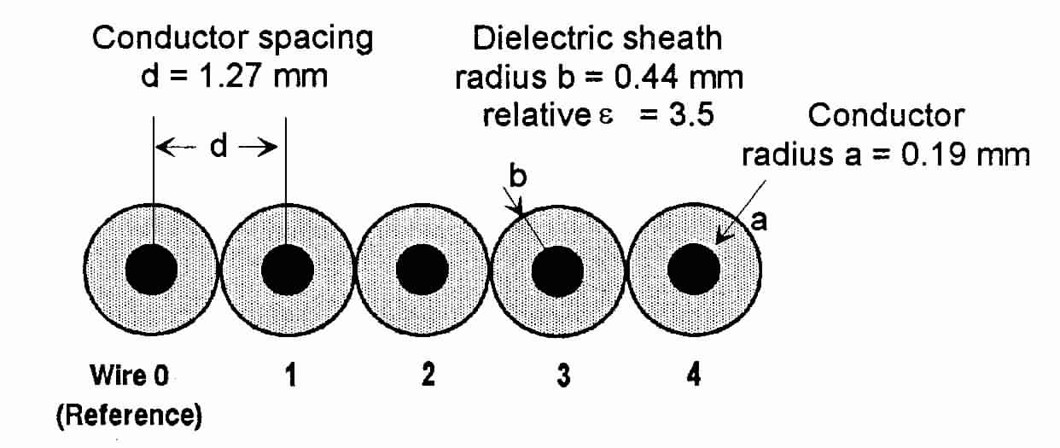
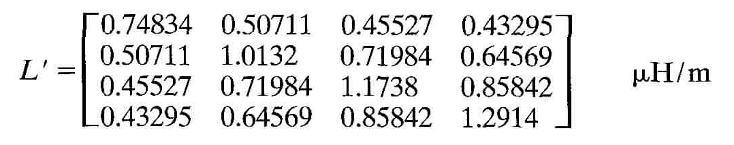
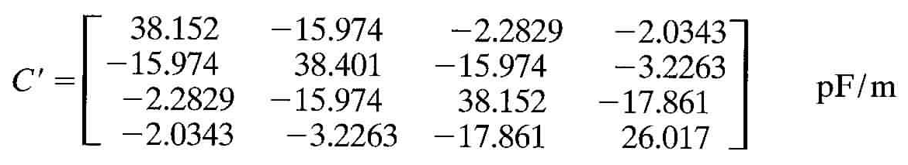
Illustration of Mode Velocities and Distributions
Consider the 5-conductor
cable in free-space
  This has 4 wires, plus a
  reference conductor
The computed [L’] and [C’] matrices are

Slide 56
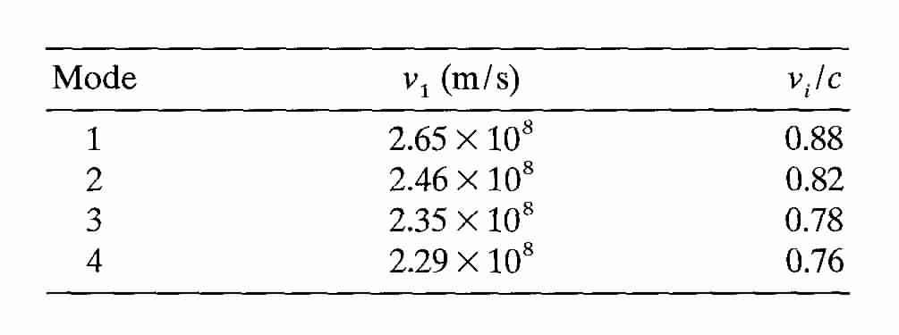
Illustration of Mode Velocities and Distributions
A numerical evaluation of the modal
velocities for this line gives the following
values

Slide 57
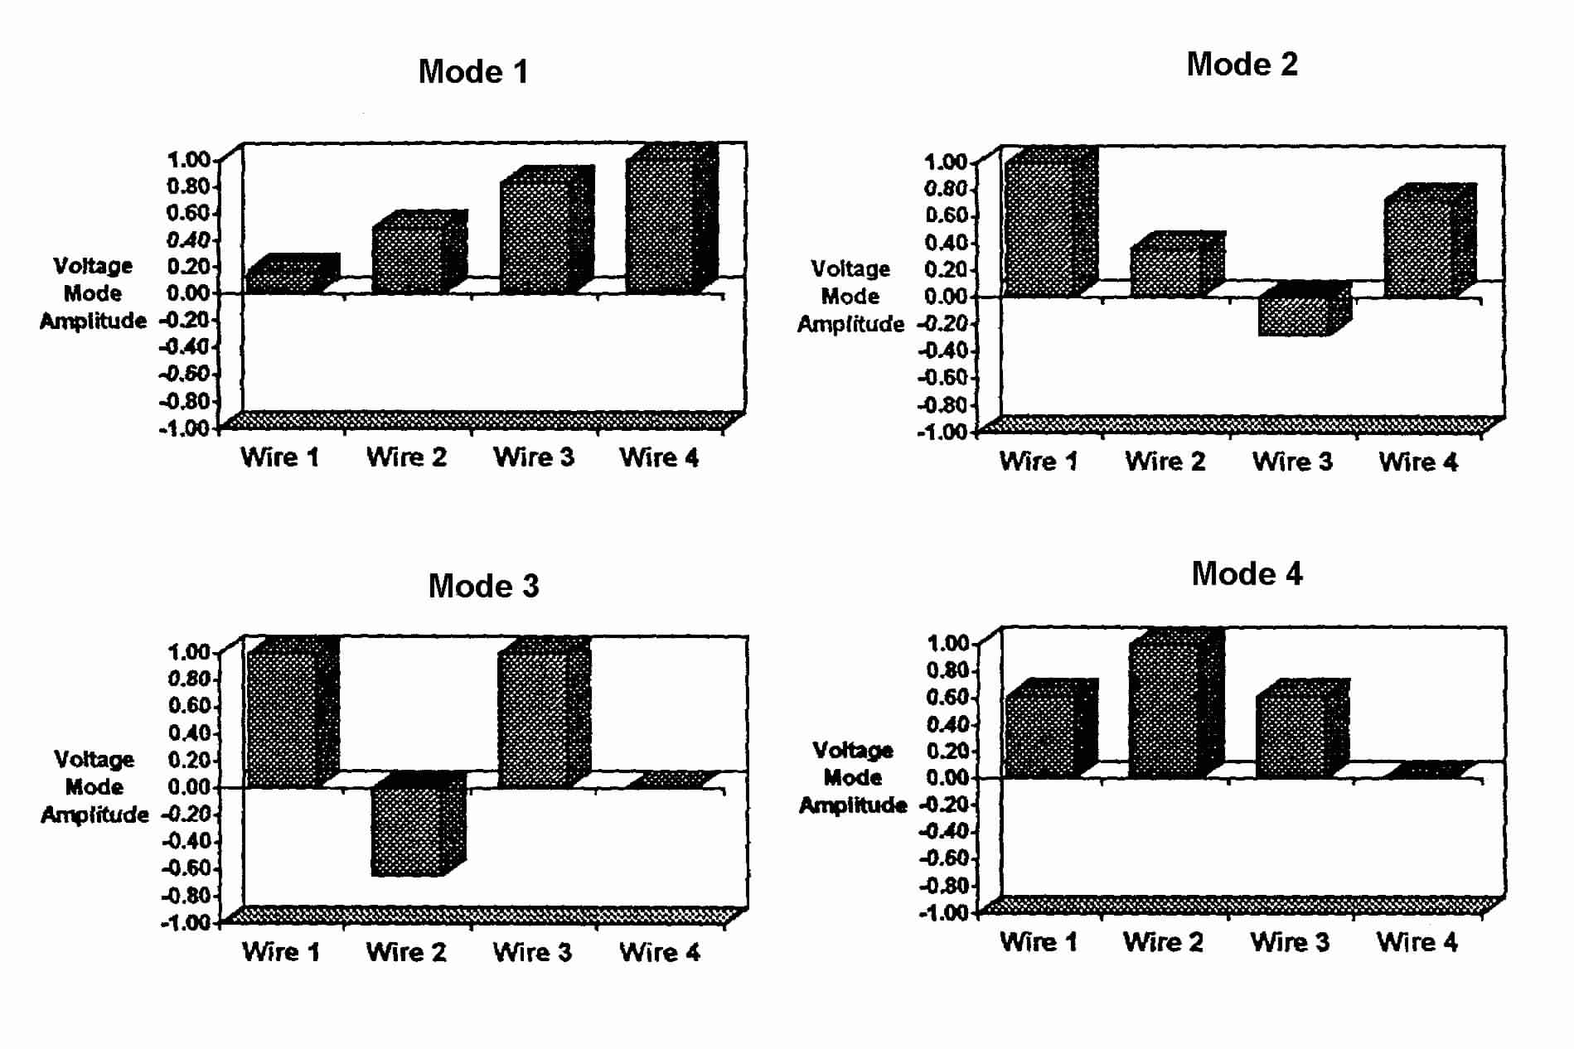
Illustration of Mode Velocities and Distributions
The voltage mode distributions on the
wires are as follows:
Remember, these correspond to the columns of [S]⁻¹, and each mode propagates with a different velocity

Slide 58
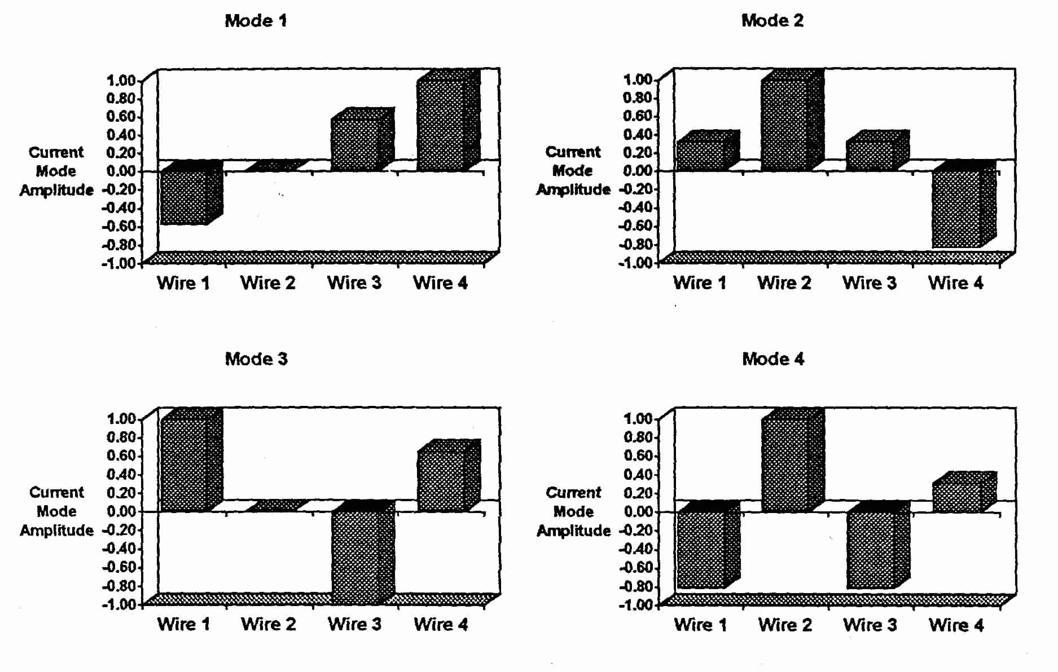
Illustration of Mode Velocities and Distributions
The current mode distributions on the
wires are as follows:
These modes correspond to the columns of [T]⁻¹, and the propagation velocities are the same as the voltage modes

Slide 59
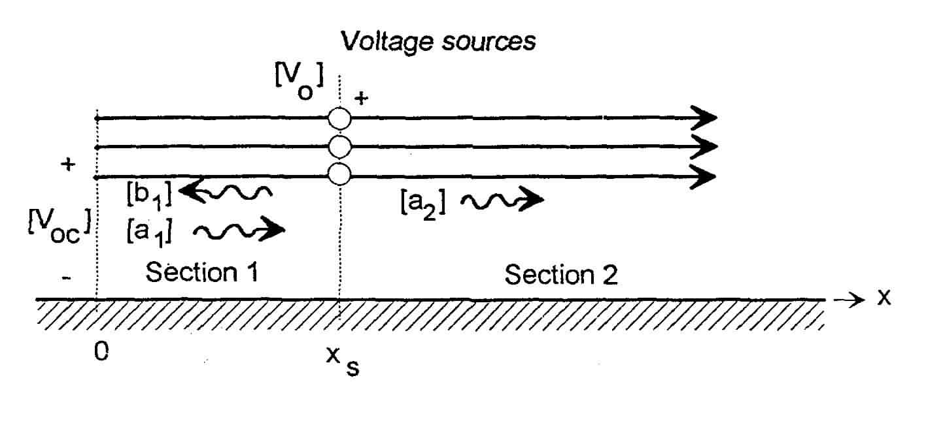
Example
Consider an infinite multiconductor line with an N-voltage source
In section #1 (0 ≤ x ≤ x_{s}) we have
At position x = 0, the current [I] = 0
  This gives so the line voltage is

Slide 60
Example (con’t)
In section #2 (x > x_{s}) we have
At the source position as x = x_{s}, we have the conditions
This leads to the following solutions for the constants
Voltage jump condition
Continuity of current

Slide 61
Example (con’t)
Evaluating the voltage in
section #1 gives
  evaluated at x = 0
  with [A₁], which has been found to be
  This gives the final expression for the open circuit voltage N-vector at the end of the line
Mode propagation occurs at different velocities
Transformation matrices “mix-up” the modes for the responses in each conductor.

Slide 62
The Equal Velocity Approximation
A major complication has been introduced by the multi-velocity analysis
  Caused by the presence of the dielectric around the wires
  How important is this effect?
For the case of no dielectric present
  All modes propagate with the speed of light
  The matrix [γ] is given by γ_{ο} [U]
  And [V_{oc}] simplifies considerably:
Consider a simple example with a step-function excitation of the cable

Slide 63
Illustration: Computed Voltage Waveform
Step function excitation
Assume wire #1 is excited by
a step function voltage source
  With the other wires unexcited
This excitation is defined as
In the frequency domain, this excitation is
For the “rigorous” multimode analysis, the voltage at x = 0 is
And for the single velocity approximation, we have
We wish to illustrate the open circuit voltage at the end of the semi-infinite line
No excitation
Source position is x_{s} = 1 meter

Slide 64
Illustration: Computed Voltage Waveform (con’t)
For this example, we will use the per-unit-length parameters determined for the 4-wire (+ reference) ribbon cable treated previously.

Slide 65
Illustration: Computed Voltage Waveform (con’t)
Plots of the spectra of the wire voltages at x = 0
Multimode analysis Single velocity approximation

Slide 66
Illustration: Computed Voltage Waveform (con’t)
The transient responses can be determined from a FTT of the spectra
Wire 1 responses Wire 2, 3 & 4 responses

Slide 67
References and Further Reading
[1] F.M. Tesche, M. Ianoz, T. Karlsson, EMC Analysis Methods and Computational Models, Wiley, 1997.

